Slide 1
Exploring the Next Generation of Novel Agents
Meletios Dimopoulos, MD
Department of Clinical Therapeutics
University of Athens, School of Medicine
Athens, Greece
www.prIMEoncology.org

Slide 2

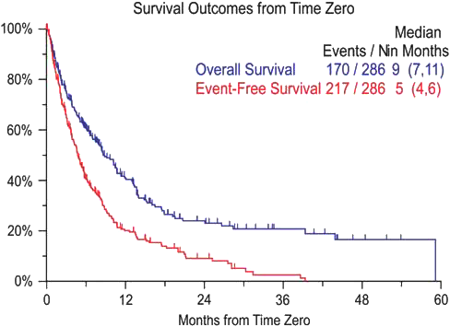
Poor Outcome for Patients Who Become Refractory to Bortezomib and Thalidomide/Lenalidomide
Kumar SK, et al. Leukemia. 2012;26(1):149-157.

Slide 3
No Satisfactory Overall Benefit Survival Even With Carfilzomib(CAR) or Pomalidomide
Median Overall Survival (OS), months
POM + LoDex (n = 302) | 13.1
HiDex† (n = 153) | 8.1
Median OS with CAR: 15.6 months
100
1.0
0.8
0.6
0.4
0.2
0
Censored observations
Confidence band
75
HR: 0.72
P = .009
Patients Alive, %
50
Proportion of Patients
25
Median OS: 15.6 months
(95% CI: 13.0-19.2)
0
0 4 8 12 16 20 24 28
OS, months
0
2.5
5.0
7.5
10.0
12.5
15.0
17.5
Months From Start of Treatment
Dimopoulos MA, et al. Blood. 2013;122: Abstract 408.
Siegel DS, et al. Blood. 2012;120(14):2817-2825.

Slide 4
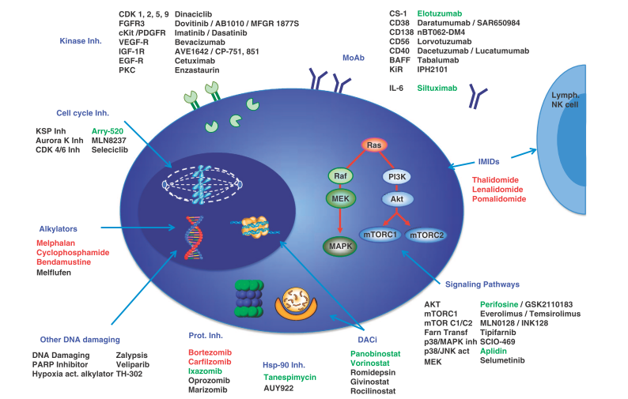
Main Targets and Therapeutic
Agents for MM
Red: Approved; Green: In phase III
Ocio E, et al. Leukemia. 2014;28(3):525-542.

Slide 5
Histone Deacetylase Inhibitors

Slide 6
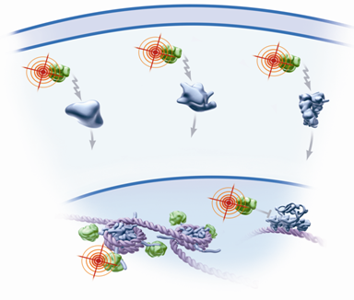
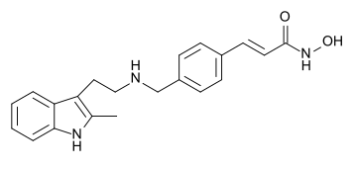
Panobinostat ~ a Pan-Deacetylase Inhibitor
PAN is a potent, oral pan-DACi that increases acetylation of proteins involved in multiple oncogenic pathways¹
PAN was synergistic with bortezomib and dexamethasone in preclinical studies of MM²⁻⁴
In phase 1 and 2 studies, PAN-BTZ-Dex demonstrated durable responses in relapsed or relapsed and refractory (R/R) MM, including BTZ-refractory disease^{5,6}
DAC
DAC
DAC
HIF-1α
HSP90
α-Tubulin
DECREASED
MOTILITY &
INVASION
DECREASED
ANGIOGENESIS
DECREASED
ONCOPROTEINS
DAC
Histones
p53
APOPTOSIS
DAC
CELL-CYCLE ARREST
Panobinostat
1. Atadja P. Cancer Lett. 2009;280(2):233-241. 2. Ocio EM, et al. Haematologica. 2010;95(5):794-803. 3. Catley L, et al. Blood. 2006;108(10):3441-3449. 4. Hideshima T, et al. Clin Cancer Res. 2005;11(24 Pt 1):8530-8533. 5. San Miguel JF, et al. J Clin Oncol. 2013;31(29):3696-3703. 6. Richardson PG, et al. Blood. 2013;122(14):2331-2337.

Slide 7


















Panobinostat + Bortezomib
Dual Inhibition of Protein Degradation Pathways
Proteasomal degradation
Bortezomib
proteasome inhibitor
Unfolded/misfolded
proteins
Ubiquitinated
protein
Proteasome
Ubiquitinated protein
aggregates
Panobinostat
Protein
degradation
Lysosomal degradation
HDAC6
dynein
Aggresome formation
Protein
degradation
Microtubule
Hideshima T, et al. Mol Cancer Ther. 2011;10(11):2034-2042.
Notes:
Notes
Protein degradation via aggresomes
Aggresome is a cellular structure that is the major site of degradation for misfolded proteins
Deacetylation is required for aggresome formation
HDAC6 binds to both polyubiquitinated misfolded proteins and dynein motors, thereby recruiting misfolded proteins for transport to aggresomes
Inhibition of deacetylation induces the accumulation of polyubiquitinated proteins and enhances cytotoxicity induced by proteasome inhibition
Reference
Hideshima T, et al. Mol Cancer Ther. 2011;10:2034-2042.

Slide 8
PANORAMA 1 Study Design
Randomized, Double-Blind, Phase III Study in
Relapsed or Relapsed and Refractory MM
Treatment phase I
Treatment phase II
Patients
(N = 768)
Relapsed or R/R
MM (BTZ-refractory excluded)
1-3 prior lines of therapy
Stratification factors
  Prior lines of therapy
  Prior BTZ
Follow-up
Eight 21-day cycles (24 weeks)
Four 42-day cycles (24 weeks)
Panobinostat +
bortezomib +
dexamethasone
Panobinostat +
bortezomib + dexamethasone
Placebo (Pbo) +
bortezomib + dexamethasone
Placebo +
bortezomib + dexamethasone
Patients with clinical benefitª in treatment phase I, can proceed to treatment phase II
ªAchieving ≥no change according to modified EBMT criteria (stable disease [SD] or better)
Primary endpoint: Progression-free survival (PFS)
(per modified EBMT criteria; confirmed by IRC)
Key secondary endpoint: OS
Other secondary endpoints: ORR, nCR/CR rate, DOR, TTR, TTP, QoL, and safety
Study conducted at 215 centers across 34 countries
ORR, overall response rate; nCR, near complete response; DOR, duration of response; TTR, time to response; TTP, time to progression; QoL, quality of life
San Miguel JF, et al. Lancet Oncol. 2014;15(11):1195-1206.
Notes:
Follow-up: 28 days post-treatment/discontinuation and every 3 months thereafter

Slide 9
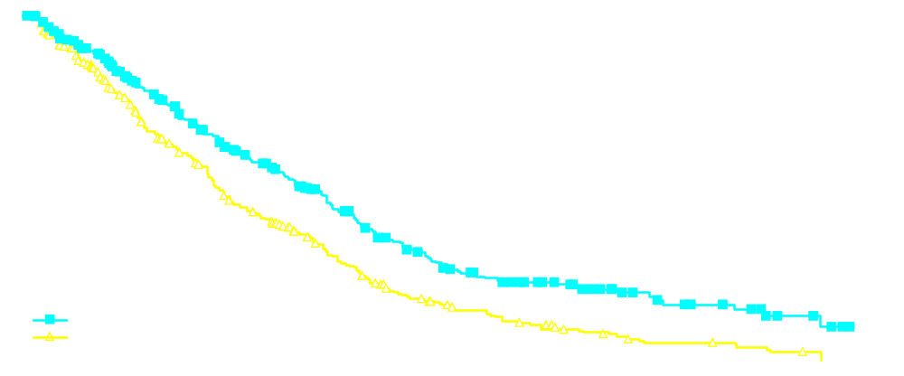
Primary Endpoint Met (PFS)
PANORAMA 1
 | Events | Median PFS (95% CI), months | HR (95% CI) | P value
PAN-BTZ-Dex | 207/387 | 12.0 (10.3, 12.9) | 0.63 (0.52-0.76) | <.0001
Pbo-BTZ-Dex | 260/381 | 8.1 (7.6, 9.2)
100
80
60
40
20
0
Progression-Free Survival Probability, %
PAN-BTZ-Dex
Pbo-BTZ-Dex
0 | 2 | 4 | 6 | 8 | 10 | 12 | 14 | 16 | 18 | 20 | 22 | 24 | 26 | 28 | 30 | 32 | 34 | 36
Number of patients at risk
Months
PAN-BTZ-Dex
Pbo-BTZ-Dex
387 | 288 | 241 | 202 | 171 | 143 | 113 | 89 | 69 | 52 | 44 | 35 | 26 | 18 | 13 | 10 | 5 | 3 | 0
381 | 296 | 235 | 185 | 143 | 114 | 89 | 64 | 42 | 32 | 24 | 18 | 12 | 5 | 5 | 3 | 2 | 0 | 0
  Primary endpoint was met (P<.0001), with clinically relevant increase in median PFS of 3.9 months for PAN-BTZ-Dex arm
San Miguel JF, et al. Lancet Oncol. 2014;15(11):1195-1206.

Slide 10

Overall Survival (Interim Analysis)
Key Secondary Endpoint
PANORAMA 1
 | Events | Median OS, months (95% CI) | HR (95% CI) | P value
PAN-BTZ-Dex | 134/387 | 33.64 (31.34, NE) | 0.87 (0.69-1.10) | NS
Pbo-BTZ-Dex | 152/381 | 30.39 (26.87, NE)
100
80
60
40
20
0
Overall Survival Probability, %
PAN/BTZ/Dex
Pbo/BTZ/Dex
0 | 2 | 4 | 6 | 8 | 10 | 12 | 14 | 16 | 18 | 20 | 22 | 24 | 26 | 28 | 30 | 32 | 34 | 36 | 38 | 40 | 42
Number of patients at risk
Months
PAN-BTZ-Dex
Pbo-BTZ-Dex
387 | 362 | 333 | 315 | 306 | 295 | 284 | 276 | 265 | 241 | 210 | 178 | 147 | 118 | 92 | 64 | 40 | 25 | 12 | 7 | 4 | 0
381 | 365 | 344 | 326 | 314 | 297 | 284 | 273 | 251 | 234 | 211 | 164 | 140 | 115 | 90 | 59 | 39 | 24 | 15 | 9 | 4 | 0
  Final OS analysis after 415 events reached
San Miguel JF, et al. Lancet Oncol. 2014;15(11):1195-1206.

Slide 11
Efficacy: Response
PANORAMA 1
 | PAN-BTZ-Dex (n = 387) | Pbo-BTZ-Dex (n = 381) | P value
ORR (PR or better) [95% CI] | 60.7% [55.7, 65.6] | 54.6% [49.4, 59.7] | .087
CR/nCR rate [95% CI] | 27.6% [23.2, 32.4] | 15.7% [12.2, 19.8] | .00006*
Median DOR [95% CI] | 13.1 months [11.8, 14.9] | 10.9 months [9.2, 11.8] | N/A
Median TTR [95% CI] | 1.5 months [1.4, 1.6] | 2.0 months [1.6, 2.8] | N/A
Median TTP [95% CI] | 12.7 months [11.8-14.9] | 8.5 months [7.7-9.7] | N/A
*Post hoc analysis
CR/nCR rate was nearly doubled vs control arm (stringent CR in PAN arm 2% vs 0% in Pbo arm)
Clinically meaningful improvements in median DOR and TTP
San Miguel JF, et al. Lancet Oncol. 2014;15(11):1195-1206.

Slide 12
Non-Hematologic Adverse Events (AEs)
Grade 3/4 Diarrhea and Asthenia/Fatigue Observed
PANORAMA 1
 | PAN-BTZ-Dex (n = 381) |  | Pbo-BTZ-Dex (n = 377)
Preferred term – % | All grades | Grade 3/4 | All grades | Grade 3/4
Diarrhea | 68.2 | 25.5 | 41.6 | 8.0
Peripheral neuropathy | 60.6 | 17.6 | 67.1 | 14.6
Asthenia/fatigue | 57.0 | 23.9 | 40.6 | 11.9
Nausea | 36.2 | 5.5 | 20.7 | 0.5
Peripheral edema | 28.6 | 2.1 | 19.1 | 0.3
Decreased appetite | 28.1 | 3.1 | 12.5 | 1.1
Constipation | 26.8 | 1.0 | 32.6 | 1.1
Pyrexia | 26.0 | 1.3 | 14.9 | 1.9
Vomiting | 25.7 | 7.3 | 13.0 | 1.3
Cough | 21.3 | 1.0 | 18.6 | 0
Discontinuation due to diarrhea (4.5%) and fatigue (2.9%) on PAN arm
San Miguel JF, et al. Lancet Oncol. 2014;15(11):1195-1206.

Slide 13
Hematologic Toxicity
PANORAMA 1
 | PAN-BTZ-Dex (n = 381) |  | Pbo-BTZ-Dex (n = 377)
Laboratory abnormality – % | All grades | Grade 3/4 | All grades | Grade 3/4
Thrombocytopenia | 97.6 | 67.4 | 83.5 | 31.4
Lymphopenia | 82.6 | 53.2 | 73.7 | 39.8
Neutropenia | 75.0 | 34.5 | 35.5 | 11.4
Anemia | 62.0 | 17.7 | 52.3 | 19.1
Discontinuation due to thrombocytopenia on PAN 1.6% (vs 0.5%)
Grade 3/4 hemorrhages on PAN 4.2% (vs 2.4%)
Grade 4 neutropenia on PAN 6.6% (vs 2.4%)
Febrile neutropenia on PAN 1% (vs 0.5%)
San Miguel JF, et al. Lancet Oncol. 2014;15(11):1195-1206.

Slide 14
VANTAGE PN088: Phase III Trial Design
Patients enrolled
(N = 637)
Dosing schedule
Analysis populations
Bortezomib
1.3 mg/m² IV on day 1, 4, 8, 11
in combination with
Vorinostat 400 mg OR placebo
Once daily on days 1–14
(21-day treatment cycle)
Intent-to-treat (ITT)
PFS, TTP, OS
Bortezomib + Vorinostat (N = 317)
Bortezomib + Placebo (N = 320)
Progressive disease after the most recent treatment
1 to 3 prior treatment regimens
Bortezomib-sensitive patients
Full analysis set (FAS)ª
ORR, safety
Bortezomib + Vorinostat (N = 315)
Bortezomib + Placebo (N = 320)
Primary endpoint:
  PFS^{b}
Secondary endpoints:
  OS, TTP, response rate (EBMT criteria), safety
ªThe primary analysis population for objective responses and included all randomized patients who received at least one dose of study treatment
^{b}Defined as the time from randomization to disease progression or death, whichever occurs first
Dimopoulos M, et al. Lancet Oncol. 2013;14(11):1129-1140.

Slide 15

EBMT Response Assessment (IAC)
Response-Evaluable Population
VANTAGE PN088
Clinical benefit rate (CBR) = 71% vs 54%, P<.0001
ORR = 56% vs 41%, P<.0001
DOR = 8.5 vs 8.4 months
Bortezomib + vorinostat (N = 315)
Bortezomib + placebo (N = 320)
IAC, independent adjudication committee
Dimopoulos M, et al. Lancet Oncol. 2013;14(11):1129-1140.

Slide 16
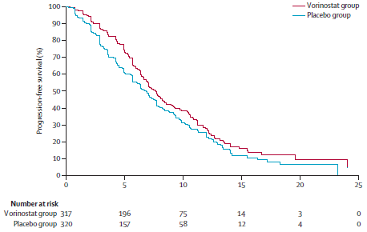
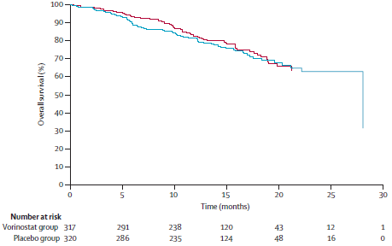
Survival Data
VANTAGE PN088
Progression-Free Survival
Overall Survival
Median PFS:
7.63 months in the vorinostat group
6.83 months in the placebo group
P =.01
Interpretation
The addition of vorinistat to bortezomib improves response rates, suggesting clinical synergism
Progression-free survival was not prolonged to a similar degree, possible because of the toxicity of the combination, which required dose reductions or treatment interruption
Different treatment schedules of bortezomib with vorinistat might improve tolerability of the combination and thus enhance its activity
Dimopoulos M, et al. Lancet Oncol. 2013;14(11):1129-1140.

Slide 17
Ricolinostat Combination Therapy With Bortezomib
Ricolinostat (ACY-1215) is an oral selective HDAC-6 inhibitor
Study patients had R/R MM with prior PI and/or IMiD agent therapy
Phase Ib dose-escalation patients (N = 22)
  Ricolinostat days 1-5, 8-12
  Bortezomib (IV) days 1, 4, 8, and 11
  Dexamethasone (po) days 1, 2, 4, 5, and 8, 9, 11, 12 in 21-day cycle
Ricolinostat combination therapy well tolerated up to 240 mg QD (days 1-5, 8-12) and 160 mg BID
Grade 3/4 GI AEs were rare with manageable hematologic AEs
25% response rate and 60% clinical benefit rate observed, including in patients refractory to bortezomib
Raje N, et al. Blood. 2013;122: Abstract 759.

Slide 18
Ricolinostat Combinations
Ricolinostat combination therapy well tolerated up to 240 mg QD (days 1-5, 8-12) and 160 mg BID
Regimen | Phase (N) | Outcomes
Ricolinostat ± bortezomib + dexamethasone¹ | I (20) | ORR: 25% (heavily pretreated) CBR: 60% (2 pts VGPR, 3 pts PR, 2 pts MR, 5 pts SD)
Ricolinostat + lenalidomide + dexamethasone² | I (22) | ORR: 64% CBR: 100% (1 pt CR, 5 pts VGPR, 8 pts PR, 3 pts MR, 5 pts SD)
1. Raje N, et al. Blood. 2013;122: Abstract 759. 2. Raje N, et al. Haematologica. 2014;99(Suppl1): Abstract P358.
Notes:
CBR, clinical benefit rate; CR, complete response; MR, minor response; ORR, overall response rate; OS, overall survival; PFS, progression-free survival; PR, partial response; SD, stable disease; VGPR, very good partial response.

Slide 19
Monoclonal Antibodies

Slide 20
Mechanism of Action of Monoclonal Antibodies
Antibody-dependent cellular cytotoxicity (ADCC)
Complement-dependent cytotoxicity (CDC)
Apoptosis/growth arrest via targeting signaling pathways
Immune
effector cells
C1q
C1q
CDC
MM
MM
ADCC
FcR
Recruitment of complement factor (C1q) by Ab bound to tumor cell
→ Triggers proteolytic cascade: generation of effector molecule, C3b, formation of membrane attack complex
→ Killing of target cell by disruption of cell membrane
Direct induction of apoptosis or growth arrest upon binding of Ab on tumor cells
MM
ADCC triggered by interactions between Ab bound to tumor cell and receptors for Ab on immune cells (neutrophils, macrophages, natural killer cells)
→ Tumor cells phagocytozed by macrophages or cytolysis by NK cells
Tai YT, et al. Bone Marrow Res. 2011;2011:924058.

Slide 21
Monoclonal Antibodies in MM
Target | mAb | Stage of development
Surface molecules
CS1 | Elotuzumab | Phase II/III
CD38 | Daratumumab SAR650984 MOR202 | Phase I/II/III Phase I/II Phase I/II
CD74 | Milatuzumab | Phase I/II
CD40 | Dacetuzumab | Phase I
CD56 | Lorvotuzumab mertansine | Phase I
CD138 | Indatuximab ravtansine | Phase I
Signaling molecules
IL-6 | Siltuximab |  | Phase III
RANKL | Denosumab |  | Phase III
B cell activating factor (BAFF) | Tabalumab |  | Phase II/III
VEGF | Bevacizumab |  | Phase II
DKK1 | BHQ880 |  | Phase II
Richardson PG, et al. Presented at IMW 2013: Abstract P-214. Plesner T, et al. Blood. 2013;122(21): Abstract 1986. Martin TG, et al. Blood. 2013;120: Abstract 284. Wong RS, et al. Blood. 2013;120: Abstract 505. Hageman K, et al. Ann Pharmacother. 2013;47(7-8):1069-1074. US National Institutes of Health. Available at: http://www.clinicaltrials.gov/ct2/show/NCT00421525; http://www.clinicaltrials.gov/ct2/show/NCT00079716; http://www.clinicaltrials.gov/ct2/show/NCT00346255; http://www.clinicaltrials.gov/ct2/show/NCT01001442. Accessed: November 5, 2014.

Slide 22

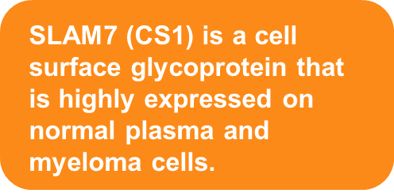
Elotuzumab: Mechanism of Action
✓
X
ADCC
CDC
X
NK cell
Apoptosis/
disrupt signalling
Elotuzumab
cytolysis
CS1
MM cell
Garg TK, et al. Blood. 2008;112: Abstract 3666. Hsi ED, et al. Clin Cancer Res. 2008;14(9):2775-2784. Tai YT, et al. Blood. 2007;110(5):1656-1663.
Notes:
Garg TK, et al. Blood. 2008;112:abstract 3666. Page 2.
Tai Y-T, et al. Blood. 2008;112:1329-37: pages 1-2; Abstract.
Tai Y-T, et al. Blood. 2008;112:1329-37: page 21; Discussion.
Hsi ED, et al. Clin Cancer Res. 2008;14:2775-84: page 2775; Abstract.
Hsi ED, et al. Clin Cancer Res. 2008;14:2775-84: page 2781; column 1; HuLuc63 mediates ADCC and in vivo antimyeloma activity that is dependent on NK cells.

Slide 23
Elotuzumab + Lenalidomide and Low-Dose Dexamethasone (LoDex) in R/R MM
Lenalidomide 25 mg, d 1-21, q 28 days
 | Elotuzumab 10 mg/kg | Elotuzumab 20 mg/kg | Total
Patients, n | 36 | 37 | 73
ORR (≥PR), n (%) | 33 (92) | 27 (73) | 60 (82)
CR/stringent CR, n (%) | 5 (14) | 4 (11) | 9 (12)
VGPR, n (%) | 14 (39) | 12 (32) | 26 (36)
PR, n (%) | 14 (39) | 11 (30) | 25 (34)
<PR, n (%) | 3 (8) | 10 (27) | 13 (18)
Median PFS, months | 33 | 18.6 | 25.8
Median time to response: 1 month (range, 0.7-5.8)
Median time to best response: 2.2 months (range, 0.7-17.5)
Lonial S, et al. J Clin Oncol. 2013;31: Abstract 8542.
Notes:
The ORR for patients refractory to their last treatment was 73%

Slide 24
Phase I/II Elotuzumab, Lenalidomide, and LoDex in R/R MM: PFS
100
90
80
70
60
Proportion of
Progression-Free Patients, %
50
40
Median time to progression/death:
10 mg/kg (n = 36): 33 months (95% CI: 14.9-NA)
20 mg/kg (n = 37): 18.6 months (95% CI 12.9-32.4)
Total (n = 73): 25.8 months (95% CI: 15.4-35.7)
30
20
10
0
0
3
6
9
12
15
18
21
24
27
30
33
36
39
Months
Median PFS:
  In the 10 mg/kg cohort: 33 months (median follow-up of 20.8 months)
  In the 20 mg/kg cohort: 18 months (median follow-up of 17.1 months)
Patient follow-up is ongoing.
Lonial S, et al. J Clin Oncol. 2013;31(Suppl): Abstract 8542
Notes:
LoDex, low-dose dexamethasone; MM, multiple myeloma; NA, not available; PFS, progression-free survival.

Slide 25
Elotuzumab Phase III Trials
ELOQUENT-1 trial¹
A phase III, randomized, open-label trial of lenalidomide/dexamethasone with or without elotuzumab in subjects with previously untreated multiple myeloma (CA204-006)
ELOQUENT-2 trial²
A phase III, randomized, open-label trial of lenalidomide/dexamethasone with or without elotuzumab in relapsed or refractory multiple myeloma (RR MM) (CA204-004)
Lonial S et al., ASCO 2012
1. Dimopoulos MA, et al. J Clin Oncol. 2012;30(suppl): Abstract TPS8113; US National Institute of Health. Available at: www.clinicaltrials.gov/ct2/show/NCT01335399. Accessed: October 29, 2014. 2. US National Institute of Health. Available at: www.clinicaltrials.gov/ct2/show/NCT01239797. Accessed: October 29, 2014.

Slide 26



Daratumumab: Mechanism of Action
ADCC
✓
CDC
✓
✓
NK cell
Complement
Apoptosis/
disrupt signalling
cytolysis
Daratumumab
cytolysis
CD38
CD38 is a receptor with enzymatic activity regulating cell adhesion and signal transduction. It is highly expressed on MM cells, and
on other immune
(CD4, CD8, B, and NK) cells
MM cell
de Weers M, et al. J Immunol. 2011;186(3):1840-1848.
Notes:
de Weers M, et al. J Immunol. 2011;186:1840-8: page 1840; Abstract.
de Weers M, et al. J Immunol. 2011;186:1840-8: page 1845, column 1, Discussion.

Slide 27
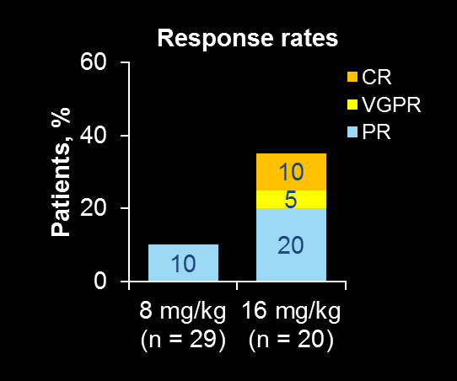
Daratumumab in R/R MM
Phase I/II Study: Outcome
Patients achieving ≥PR at 16 mg/kg with BM involvement cleared BMPC after daratumumab treatment
Safety
In 16mg/kg cohort, 50% of patients experienced infusion-related reaction (prophylaxis is mandatory); all infusion reactions were grade 1/2
Most common grade 3/4 AEs (in ≥10% of patients):
  8 mg/kg cohort: thrombocytopenia (13%), pneumonia (10%)
  16 mg/kg cohort: lymphopenia (10%)
Progression-free survival
100
80
8 mg/kg (N = 29)
16 mg/kg (N = 20)
60
ORR:35%
Estimated probability (%)
23 wks
40
20
ORR:10%
14.9 wks
0
0
4
8
12
16
20
24
28
32
36
40
44
48
Weeks from start of treatment
Lokhorst H, et al. Haematologica. 2014;99(Suppl1): Abstract P356.
Notes:
Lokhorst H, et al. EHA 2014:abstract P356. Poster presentation; Figure 2; Figure 4
Lokhorst H, et al. EHA 2014:abstract P356. Poster presentation; Table 3
Lokhorst H, et al. EHA 2014:abstract P356. Poster presentation; Conclusions

Slide 28
Daratumumab + Lenalidomide + Dex in R/R MM Phase I/II
3x3 dose-escalation study
Primary objective: safety; secondary objectives: efficacy and pharmacokinetics
Median number of prior therapies: 2.5
  13.6% of patients was Len-refractory, 50% of patients were Len-naïve
Part 1: Dose escalation
Part 2: Expansion cohort
N = 22
R/R MM
Part 1:
2-4 prior lines of therapy
Part 2:
≥1 prior line of therapy
No primary refractory disease
DARA-Rd
Dose-escalation: 3 + 3 scheme
DARA: 2-16 mg/kg, IVª
Len: 25 mg, d1-21
Dex: 40 mg weekly
Twenty-four 28-day cycles
DARA-Rd
DARA: 16 mg/kg, IVª
Len: 25 mg/kg, d1-21
Dex: 40 mg weekly
Twenty-four 28-day cycles
ªCycle 1-2: weekly daratumumab A, cycle 3-6: D1,15; cycle 7-24: D1
DARA-Rd, daratumumab lenalidomide
Plesner T, et al. Haematologica. 2014;99(Suppl1): Abstract P350.
Notes:
Plesner T, et al. EHA 2024;abstract P350. Poster presentation: Methods, Figure 1, Key Inclusion Criteria
Plesner T, et al. EHA 2024;abstract P350. Poster presentation: Table 1

Slide 29
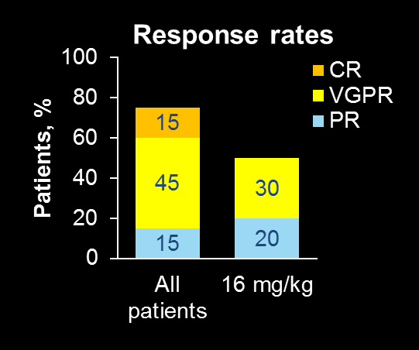
Daratumumab + Lenalidomide + Dex in RR MM Phase I/II
Maximum tolerated dose was not reached, recommended phase II dose was established at 16 mg/kg
  ORR: 75% (all 3 Len-refractory patients achieved ≥PR)
  ORR was 92.3% for part 1 patients (12/13) who had ≥2 months of follow up or discontinued earlier
Safety
Infusion reactions (grade 1/2) reported in 18% of patients
Most frequent AEs occurring in >25% of patients (any grade):
  Hematological: Neutropenia (31.8%)
  Nonhematological: Diarrhea (31.8%); fatigue (27.3%);
  nasopharyngitis (27.3%), and constipation (27.3%)
Best response and duration of follow-up
(efficacy analysis set)
x
PR
x
ORR:75%
PR
VGPR
#
ORR:50%
PR
PR
VGPR
CR
#
PR
PR
VGPR
CR
#
PR
x
PR
PR
CR
Patient Number
PR
VGPR*
PR
PR
VGPR*
16 mg/kg
8 mg/kg
4 mg/kg
2 mg/kg
PR
VGPR*
PR
PR*
0
4
8
12
16
20
24
28
32
36
40
44
48
52
56
60
64
68
Time From First Dosing (weeks)
* A response marked with an asterisk is unconfirmed
First response; Best response
X – discontinued the study due to disease (2 patients) and1 adverse event (1 patient)
# – prior Len refractory
Plesner T, et al. Haematologica. 2014;99(Suppl1): Abstract P350.
Notes:
Plesner T, et al. EHA 2024;abstract P350. Poster presentation: Figure 2; Table 6
Plesner T, et al. EHA 2024;abstract P350. Poster presentation: Conclusions
Plesner T, et al. EHA 2024;abstract P350. Poster presentation: Safety; Table 3

Slide 30
CD38 Monoclonal Antibody SAR650984
Phase I dose-escalation study, SAR650984 targeting selected CD38+ hematological malignancies; primary objective, MTD / maximum absorbable dose (MAD)
SAR650984 administered weekly or every 2 weeks to 34 myeloma patients
MTD not reached with weekly or biweekly schedule
Time to initial response (CR, PR, MR, median) 6.1 weeks
(range: 3.4-12.3)
Shows favorable safety profile in hematological malignancies
Clinical response correlated with bone marrow plasma cell clearance
Martin TG, et al. Blood. 2013;120: Abstract 284.

Slide 31
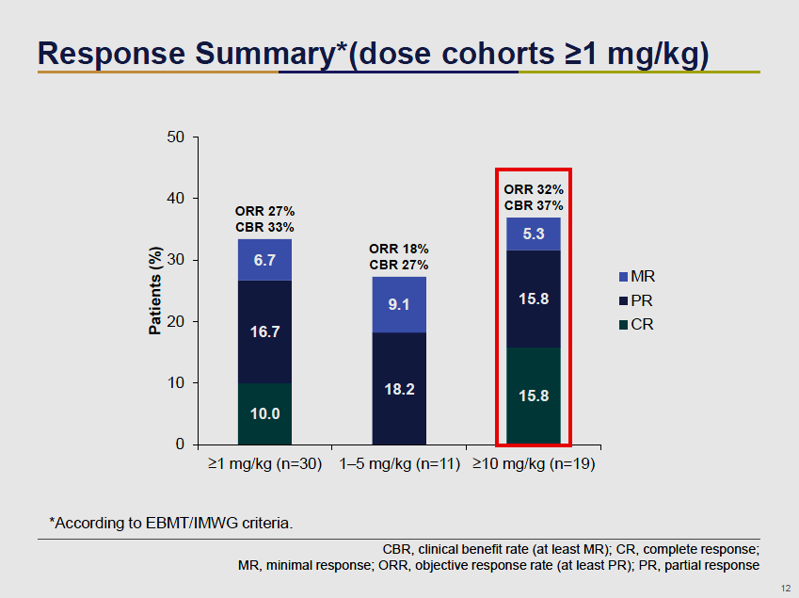
SAR650984 in MM
Time to initial response (CR, PR, MR, median) 6.1 wks (range: 3.4-12.3)
Martin TG, et al. Blood. 2013;120: Abstract 284.

Slide 32
Indatuximab Ravtansine With Lenalidomide and Low-Dose Dexamethasone
Phase I/Ila study of indatuximab ravtansine, an antibody-drug conjugate targeting CD138-expressing tumor cells, in combination with lenalidomide and dexamethasone in patients with R/R MM
Phase I: 3 + 3 dose escalation (80, 100, and 120 mg/m²) to determine dose-limiting toxicity and MTD
Phase IIa: MTD cohort expansion to a total of 37 patients to describe response rates
Treatment regimen: 28-day cycle:
  Indatuximab ravtansine: Days 1, 8, 15
  Lenalidomide: 25 mg/day for 21 days
  Low-dose dexamethasone: 40 mg/day on days 1, 8, 15, 22
  Treatment cycles repeated until disease progression or unacceptable toxicity
Kelly K, et al. Blood. 2013;120: Abstract 758.

Slide 33
Indatuximab Ravtansine: Results
Indatuximab ravtansine with lenalidomide and low-dose dexamethasone achieved responses (including CR) at MTD and below, suggesting the combination is active at well-tolerated doses
MTD defined as 100 mg/m²
MAD at 120 mg/m²; anemia and mucositis reported as dose-limiting toxicities
100% of evaluated patients (n = 15) achieved SD or better, including 2 CRs, 4 VGPRs, 5 PRs (ORR 73%)
  ≥PR in 6 of 8 Len/Dex refractory patients (ORR 75%)
  ≥PR in 8 out of 9 patients treated at MTD (ORR 89%)
Kelly K, et al. Blood. 2013;120: Abstract 758.

Slide 34
Kinesin Spindle Protein Inhibitors

Slide 35
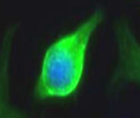
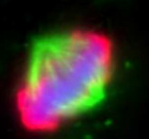
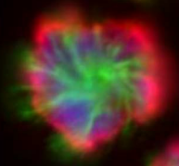
Filanesib (ARRY-520):
Mechanism of Action
ARRY-520 is a kinesin spindle protein (KSP) inhibitor
  KSP inhibition prevents formation of bipolar spindle
  Inducing rapid apoptosis leading to cell death
Cancer cell
KSP
ARRY-520
Normal spindle:
proliferation
Monopolar spindle:
arrest & apoptosis
Shah JJ, et al. Blood. 2012;120:Abstract 449.
Notes:
Shah JJ, et al. http://www.arraybiopharma.com/_documents/Publication/PubAttachment556.pdf. Accessed 27 September 2013. Page 3, 5.

Slide 36
Filanesib ± Dexamethasone in R/R MM:
Phase II Study Data
Cohort 1: Filanesib single agent, n = 32, median of 6 prior treatments
Cohort 2: Filanesib + dexamethasone, n = 55, median of 8 prior treatments
  Bortezomid-refractory: 53% (cohort 1) and 98% (cohort 2)
  Len-refractory: 75% (cohort 1) and 100% (cohort 2)
  Triple-refractory: 41% (cohort 1) and 96% (cohort 2)
Outcome | Filanesib single-agent, n = 32 | Filanesib + Dex n = 55
ORR (≥ PR), % | 16 | 15
Median duration of response (≥PR), months | 8.6 | 5.1
TTNT, months | 3.7 | 3.4
OS, months | 19.0 | 10.5
Lonial S, et al. Blood. 2013;122: Abstract 285.

Slide 37
Filanesib Single Agent Therapy in R/R MM
Hematological AEs
Neutrophils
n = 32
Grade 3
Platelets
Grade 4
Hemoglobin
Bleeding
Febrile Neutropenia
0
25
50
75
100
% Incidence
Nonhematological AEs
n = 32
Pneumonia
Grade 3
Grade 4
Hypokalemia
Back pain
Fatigue
0
25
50
75
100
% Incidence
Lonial S, et al. Blood. 2013;122: Abstract 285.

Slide 38
AAG and Outcomes
 | Filanesib single-agent |  |  | Filanesib + Dex
 | All patients | AAG-High | AAG-Low | All patients | AAG-High | AAG-Low
N | 32 | 6 | 21 | 55 | 15 | 36
ORR (≥PR) | 5 (16%) | 0 (0%) | 5 (24%) | 8 (15%) | 0 (0%) | 7 (19%)
CBR (≥MR) | 7 (22%) | 0 (0%) | 7 (33%) | 11 (20%) | 0 (0%) | 10 (28%)
DOR, months | 8.6 | - | 8.6 | 5.1 | - | 5.1
Time to next treatment, months | 3.7 | 2.6 | 5.3 | 3.4 | 2.0 | 5.1
OS, months | 19.0 | 4.5 | 23.3 | 10.5 | 2.9 | 10.8
AAG, Alpha1-acid glycoprotein
Lonial S, et al. Blood. 2013;122: Abstract 285.

Slide 39
Survival Curves Relative to AAG Levels
Single-agent filanesib
(median 6 previous therapies)
Low*
High
All
Filanesib + Dex
(median 8 previous therapies)
100
75
50
25
0
100
75
50
25
0
Survival (%)
Survival (%)
0 6 12 18 24 30 36
OS, months
0 6 12 18 24 30 36
OS, months
Lonial S, et al. Blood. 2013;122: Abstract 285.

Slide 40
Filanesib, Carfilzomib, and Dexamethasone in R/R MM
Median number of prior lines: 4 (2-10), 80% were Len-refractory, 90% received prior ASCT
Induction
Maintenance
FILA: 0.75-1.5 mg/m²,
D1-2, 15-16
Carfilzomib: 20/27 mg/m²,
D1-2, 8-9, 15-16
Dex: 4 mg, D1-2, 8-9,
15-16
Eight 28-day cycles
Carfilzomib: 20/27 mg/m²,
D1-2, 15-16
Filanesib: MTD,
D1-2, 15-16
Until PD
N = 20
prior treatment
full cycles
of PIs and IMiDs
bortezomib refractory, or intolerant
MTD was established at ARRY 1.5 mg/m²
ORR was 37% (≥MR: 63%)
Most common grade 3-4 AEs were neutropenia (45%), anemia (30%), thrombocytopenia (30%), fatigue (15%), gastrointestinal (15%)
Shah JJ, et al. Blood. 2013;122: Abstract 1982.

Slide 41
Cell Cycle Inhibitors

Slide 42
Plitidepsin in R/R MM
Plitidepsin, 5 mg/m2 administerd as 3-hour IV infusion Q2W (ie, one cycle equaled two weeks)
Dex was permitted if suboptimal response (PD or SD after 3 or 4 plitidepsin cycles): 20 mg/day orally on days 1 to 4 every two weeks
 | Subgroup |  |  | Overall treatment response
 | Before availability of Dex addition | After availability of Dex addition
 | Plitidepsin | Plitidepsin | Plitidepsin + Dex | Plitidepsin | All patients
ITT population
n | 23 | 9 | 19 | 51 | 51
ORR, n (%) | 2 (8.7%) | 1 (11.1%) | 4 (21.1%) | 6 (11.8%) | 7 (13.7%)
PP population
n | 21 | 8 | 18 | 47 | 47
ORR, n (%) | 2 (9.5%) | 1 (12.5%) | 4 (22.2%) | 6 (12.8%) | 7 (14.9%)
Status to prior steroid therapy (36) | Best response to plitidepsin alone | Addition of Dex? | Status at the time of Dex addition | Best response to plitidepsin + Dex
Mateos M, et al. Clin Cancer Res. 2010;16(12):3260-3269.

Slide 43

Plitidepsin in R/R MM
1.0
0.9
APL
APL/APL+ Dex
0.8
Censored
0.7
Median TTP:
APL: 2.3 months, 95% CI 1.5-2.8
APL/APL + Dex: 4.2 months, 95% CI 3.4-7.7
0.6
0.5
0.4
P = .0045
0.3
0.2
0.1
0.0
0
1
2
3
4
5
6
7
8
9
10
Time, months
APL, plitidepsin
Mateos M, et al. Clin Cancer Res. 2010;16(12):3260-3269.

Slide 44
Conclusions
Need for more novel agents for later lines of therapy as the “historic” novel drugs go upfront
New drug classes with new mechanisms of action are entering the fray against myeloma
More targeted drugs may reduce toxicities
Antibodies will be combined with conventional therapy leading to a R-CHOP like approach in treatment of multiple myeloma
We need to identify mechanisms of resistance and associated clinically relevant biomarkers to target therapy in the relapsed setting

